Slide 1
How Settlement Funds Can Accelerate Addressing the Overdose Crisis and Spur Innovation
Miriam Delphin-Rittmon, PhD
Assistant Secretary for Mental Health and Substance Use
Substance Abuse and Mental Health Services Administration
U.S. Department of Health and Human Services
Georgetown University Law Center
September 24, 2021
Notes:
Presentation title slide
Do not change colors
Add title where designated

Slide 2
State Opioid Response (SOR) Grant
The aims of this program are to address the opioid crisis by increasing access to medication-assisted treatment using the FDA-approved medications for the treatment of opioid use disorder (OUD), reducing unmet treatment needs, and reducing opioid overdose related deaths through the provision of prevention, treatment and recovery activities for OUD.
In FY 2020, the SOR program was expanded to support evidence-based prevention, treatment and recovery support services to address stimulant misuse and use disorders, including for cocaine and methamphetamine.
Ohio Care Line - Connects Ohioans struggling with pandemic-related anxiety, depression, stress, and substance use with trained support professionals who listen and refer them to local behavioral health resources and services.
Tennessee Regional Overdose Prevention Specialist (ROPS) - trained more than 28,000 individuals on Opioid Use Disorder and Harm Reduction Strategies.

Slide 3
Tribal Opioid Response (TOR) Grant
This program aims to address the opioid crisis in Tribal communities by increasing access to culturally appropriate and evidence-based treatment, including medication-based treatment using one of the three FDA-approved medications for the treatment of opioid use disorder (OUD).
The intent is to reduce unmet treatment needs and opioid overdose related deaths through the provision of prevention, treatment, and recovery support services for OUD and, if so desired, stimulant misuse and use disorders.
Great Plains Tribal Chairmen’s Health Board – Completed 19-week webinar education series on the effects of drugs, overdosing, and drug trafficking. Also connected over 100 clients to MAT treatment.
White Earth Band of Chippewa Indians – established a recovery-oriented community program. As a result of services provided through this program, the grantee has been able to bill Medicaid and become self-sustaining.
Notes:
3

Slide 4
Medication Assisted Treated-Prescription Drug and Opioid Addiction (MAT-PDOA)
Aims to expand and enhance access to medication-assisted treatment (MAT) services for persons with an opioid use disorder (OUD) seeking or receiving MAT.
The tribal MAT-PDOA grantees have included culturally-based innovative interventions to improve access to treatment and retention. The treatment models/approaches used to support MAT services either have been uniquely designed for native populations or adapted to be so, such as community education materials based on traditional culture.
Rutgers University – initiated a peer navigators specialist program. As a result of this program, there was a marked instantaneous uptake of dosing and prescribing of Buprenorphine/Suboxone increased by 22.4%.
Rushford - implemented TryCycle an app to connect client, clinician, doctor and recovery specialist. Since the inception of the app, over 7,000 interventions have been made and the program reports there has been no overdose deaths or suicide attempts.

Slide 5
First Responders - Comprehensive Addiction and Recovery Act (FR CARA)
The purpose of this program is to allow first responders and members of other key community sectors to administer a drug or device approved or cleared under the Federal Food, Drug, and Cosmetic Act (FD&C Act) for emergency reversal of known or suspected opioid overdose.
In SAMHSA’s work, first responders include firefighters, law enforcement officers, paramedics, emergency medical technicians, or other legally organized and recognized volunteer organizations that respond to adverse opioid related incidents.
DuPage County Health Department in IL – to share information the grantee developed a GIS maps to show Naloxone administrations by municipality, substance use treatment providers, drug take back boxes, opioid overdose reversals and cause of death data from Coroner’s office.
Philadelphia Department of Public Health - implemented a new EMS alternative response unit known as AR-2. A paramedic and case manager ride together in AR-2, which is a marked Fire Department SUV, and respond when an individual revived from an opioid overdose declines ambulance transport to a hospital but is interested in seeking help for substance use disorder.

Slide 6
Grants to Prevent Prescription Drug/Opioid Overdoes-Related Deaths (PDO)
The PDO grant program is designed to reduce the number of prescription drug/opioid overdose-related deaths and adverse events among individuals 18 years of age and older.
The program funds training first responders and other key community sectors on the prevention of PDO deaths and implementing secondary prevention strategies, including the purchase and distribution of naloxone to first responders.
Oklahoma – developed an updated naloxone distribution strategy in response to COVID-19. The state now distributes naloxone to everyone that has a MOUD prescription.
South Carolina – enhanced and expanded a web-based naloxone reporting system for both law enforcement agencies and firefighters.
Notes:
6

Slide 7
Harm Reduction Grants Program
Encourage individuals to take steps to reduce the negative personal and public health impacts of substance use. Reduce access barriers for underserved populations, reduce stigma and increase inclusivity.
Connect individuals to overdose education, counseling, and referral to treatment for infectious diseases. Support distribution of opioid overdose reversal medication.
Equipment and supplies such as: Medication lock boxes; Safe sex kits, including PrEP resources and condoms; Safe smoking kits/supplies; Syringes to prevent and control the spread of infectious diseases; Screening and testing for infectious diseases (HIV, HBV, HCV, etc.); Sharps disposal and medication disposal kits; Substance test kits, including test strips for fentanyl and other synthetic drugs; Syringes to prevent and control the spread of infectious diseases; Vaccination services (hepatitis A, hepatitis B); and Wound care management.
Notes:
Address emerging needs related to the Overdose Epidemic.
7

Slide 8
Tribal Behavioral Health Grant Program (a.k.a. Native Connections)
Native Connections is intended to reduce the impact of mental and substance use disorders, foster culturally responsive models that reduce and respond to the impact of trauma in AI/AN communities, and allow AI/AN communities to facilitate collaboration among agencies to support youth as they transition into adulthood.
The intent of this program is to prevent and reduce suicidal behavior and substance use among AI/AN youth through the age of 24 years.
Kitchen Table Talks – focus on culture and tradition and live painting sessions with artist to help families stay active and connected.
Alaska – prior to COVID-19, monthly meetings were held with youth and adults to address community problems, including substance use and abuse.
Notes:
8

Slide 9
Strategic Prevention Framework for Prescription Drugs (SPF Rx)
The program is designed to raise awareness about the dangers of sharing medications and work with pharmaceutical and medical communities on the risks of overprescribing to young adults.
The SPF Rx program also raises community awareness and brings prescription drug abuse prevention activities and education to schools, communities, parents, prescribers, and their patients.
WV Department of Health and Human Resources – started a statewide education campaign to change the stigma around substance use addiction so more people with an SUD can get treatment.
Oklahoma and tribal grantee – collaborated to enhance data sharing and PDMP usage.
Notes:
9

Slide 10
Other Considerations
Data:
Developing comprehensive data and analysis using patient-centered outcomes research
Improving data collection, particularly for underrepresented populations such as rural, LGBTQ+, criminal justice.
Healthcare:
Improving quality and access to care and creating strong continuums of care, particularly for those in crisis
Addressing healthcare inequities, particularly in racial and ethnic minorities, LGBTQ, and rural populations
expand access and reimburse for telehealth services
Housing:
Increase efforts to secure stable housing for those suffering from SUDs
Criminal Justice:
Adopt diversion strategies to help reduce the numbers of seriously mentally ill individuals and those with SUD both entering and exiting the criminal justice system

Slide 11
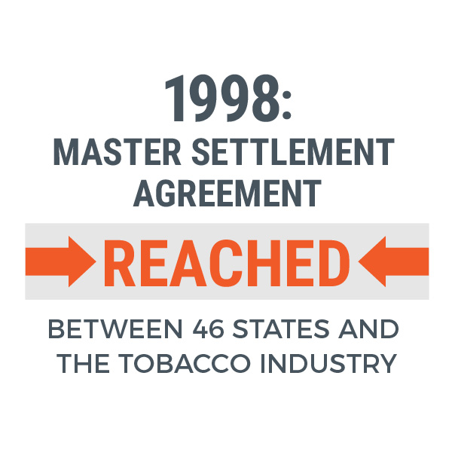
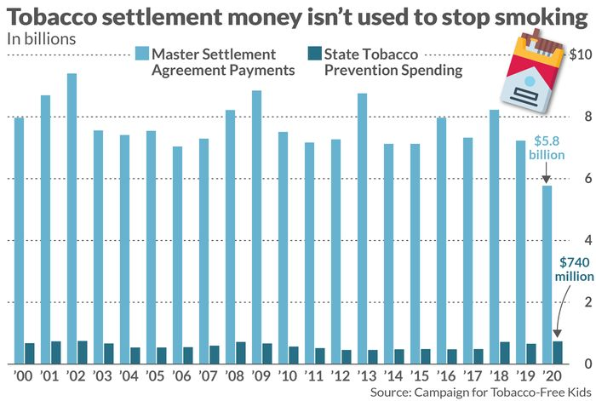
Lesson From The Past

Slide 12
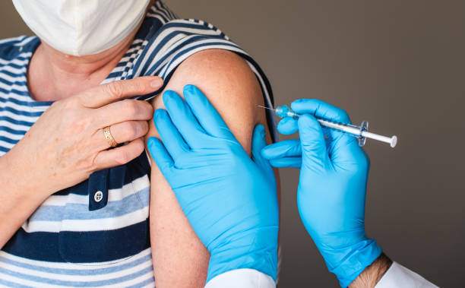
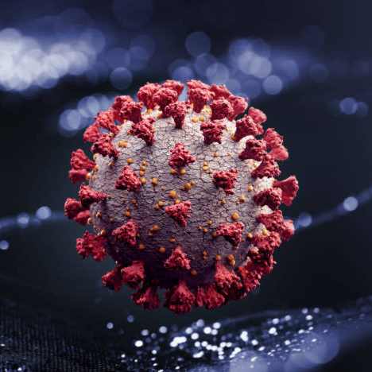
Thank You

