Slide 1
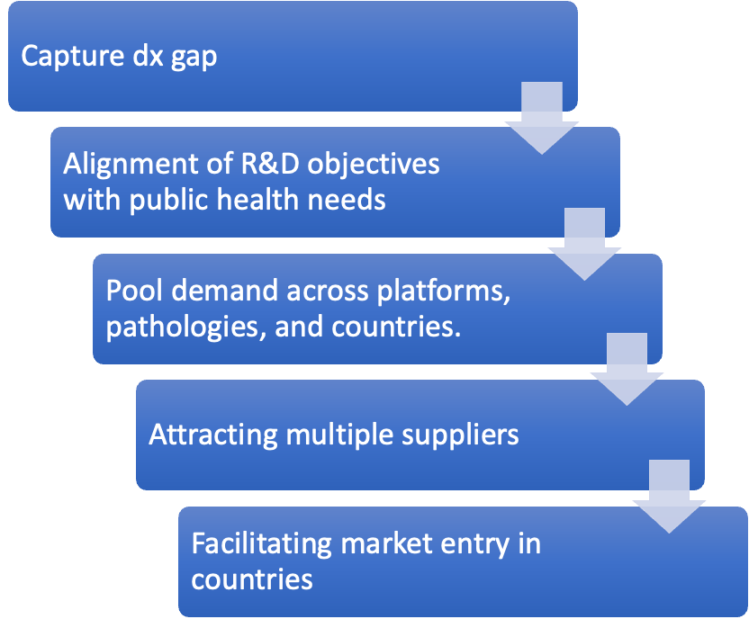
Global diagnostics facility
•Pool demand across platforms, pathologies, and countries.
A global diagnostics facility would pool demand and provide market access for local manufacturers, including SMEs in LMICs, to keep the supply side healthy and robust, ensuring efforts to mobilize support for local production aren't squandered due to lack of market access.
Benefits for manufacturers
Tech transfer hub (developer to manufacturer, manufacturer to manufacturer)
Sourcing and linkage to raw materials suppliers
Access to external markets by aggregating demand
Financial & technical assistance with WHO Prequalification applications
Provide key market intel to manufacturers
Access to capital expenditure
Notes:
Without concerted efforts to shape the market, political and financial support for local manufacturers may be wasted due to the risk of limited market access for small and medium enterprises (SMEs) in LMICs. The GDxF could channel demand to ensure a healthy and robust supply across multiple suppliers, including SMEs in LMICs.
A global diagnostics facility would pool demand and provide market access for local manufacturers, including SMEs in LMICs, to keep the supply side healthy and robust, ensuring efforts to mobilize support for local production aren't squandered due to lack of market access.

