Slide 1
Civil society perspectives: principles, tensions, and call to action
Sun Kim
People’s Health Institute
People’s Health Movement Korea
Enablers for local production of medical tools in LMICs
Panel 3: Perspectives and positions: actors’ plans and a call to action
3 May 2023
Notes:
Thank you, Sharonann.
Let me share ‘my version’ of civil society perspectives on “local production of medical tools in LMICs.”

Slide 2
Landscape of local production initiatives
No landscape by nobody
Before Covid (Velásquez, 2021)
UNCTAD and UNIDO: for LP
World Bank and WHO: vague, even against LP
After Covid: due to the global supply chain disruption; esp. vaccine nationalism
UN and other multilateral agencies (UNCTAD, UNDP, UNICEF, UNIDO, UN Tech Bank, WHO, WTO…)
Tech Access Partnership (TAP) (May 2020)
World Local Production Forum (WLPF) (June 2021)
Regional initiatives (AU, EU for Africa)
Partnerships for African Vaccine Manufacturing (PAVM) (April 2021)
African Pharmaceutical Technology Foundation (APTF) (Dec 2022)
Global Fund, Gavi
National initiatives before & after Covid
Notes:
The reason why we, as Unitaid NGO Delegation, organized this webinar was that there was no landscape by nobody on this popular subject.
Each party deals with its own initiative only, and there are different, even contradicting, interests behind the scenes.
Local production has been on the plate by the UN and other multilateral agencies even before Covid. UNCTAD and UNIDO have tried to promote and support local production; while World Bank and WHO, have not been clear or have even advised against local production in LMICs.
Since the pandemic, local production has been revitalized due to global supply chain disruption and, specifically, vaccine nationalism.
Not only the multilateral agencies but there have also been regional initiatives, namely by and for Africa, as well as by ‘partnership organizations’ like Global Fund and Gavi, which have strong purchasing power in the medical tools market in LMICs.
There have also been national initiatives of course, before and after Covid.

Slide 3
Political economy of local production
Tensions
Scale of economy, efficiency
Industrial policy
'Enablers & barriers’ and commercial business model
IP system
Tensions lead to questions about principles: why & how LP
Notes:
In this presentation, I would like to focus on the political economy of local production instead of its technical aspects. Meaning that I would not prescribe detailed action plans, but rather criticize the interests, ideologies, and power behind the ongoing local production initiatives.
There are tensions between different interests, and this leads to questions about principles of local production from civil society perspectives.
As we’ve so far listened to the perspectives of civil society and like-minded parties, let us listen to the voice of others.

Slide 4
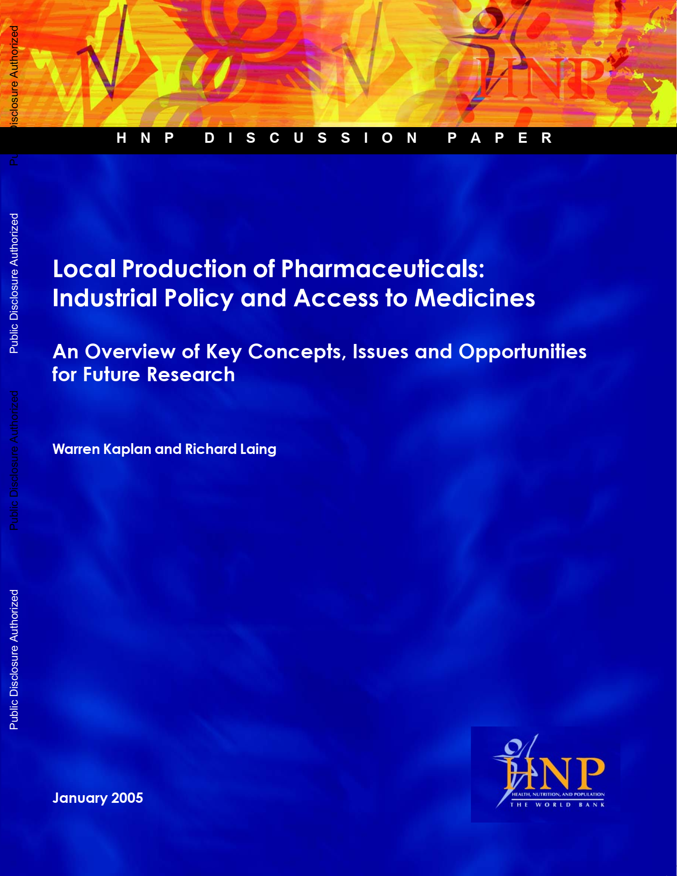
Tension (1) scale of economy, efficiency
World Bank (2005) on local production
LP makes sense only when…
Cheaper than import; with scale of economy, efficiency
Even if it is true, based on the Covid experiences, it is also evident that cheaper price is not the only reason for LP
Availability, before affordability
Right to production, control over production, beyond access
Notes:
First, let us listen to the voice of the world bank before Covid.
World Bank published a monumental report in 2005 on local production. This is 18 years ago, but the arguments presented in the report are still repeated now.
The authors said local production makes sense only when it is cheaper than import; with a scale of economy, efficiency
Even if it is true, based on the Covid experiences, it is also evident that cheaper price is not the only reason for local production
It has been highlighted that even availability, before affordability, matters; and that
Right to production, control over production, beyond access, would be key for the pandemic response, not to be dependent on the HICs and TNCs based on those.

Slide 5
Tension (2) industrial policy
World Bank (2005) on local production
Industrial policy reasons for LP may contradict health policy reasons
Self-sufficiency, less import & more export, industrial development etc.
Even if it is true, since Covid, not only LMICs but also HICs have tried to implement local production (incl. R&D) and demanded preferential supply accordingly;
This may further concentrate the control over medical tools’ production in a few HICs, which further necessitates LMICs’ LP (Velásquez, 2021)
Notes:
The report also said industrial policy reasons for local production may contradict health policy reasons
Industrial reasons would include self-sufficiency, less import & more export, industrial development etc.
Even if it is true, since Covid, not only LMICs but also HICs have tried to implement local production (incl. R&D) and demanded preferential supply accordingly; and
This may further concentrate the control over medical tools’ production in a few HICs, which further necessitates LMICs’ local production

Slide 6
Tension (3) 'enablers & barriers’ and commercial business model
IFPMA (2023) on local production
feasible only if…
Countries with adequate technical expertise, reliable quality controls, appropriate legal and financial frameworks, and a viable market
“Reflects the commercial business model of the pharmaceutical industry”
extremely challenging when…
Countries do not have the local technical know-how or economic scale
In principle, these are
man-made, politically modifiable factors; and
NOT natural or everlasting enablers & barriers for LP
Further, based on the Covid experiences, it is evident that the commercial business model has failed in delivering medical tools in LMICs
Notes:
Next, International Federation of Pharmaceutical Manufacturers and Associations (IFPMA) recently published a report titled <The Changing Landscape on Access to Medicines>. There is a chapter on access to medicines and IP and a sub-chapter of it on local production.
The industry says local production is feasible only if countries meet adequate technical expertise, reliable quality controls, appropriate legal and financial frameworks, and a viable market. And in this case, they say, local production reflects the commercial business model of the pharmaceutical industry.
The report also says local production is extremely challenging when countries do not have the local technical know-how or economic scale.
In principle, these are man-made, and politically modifiable factors and NOT natural or everlasting enablers & barriers for local production.
Further, based on the Covid experiences, it is evident that the commercial business model has failed in delivering the medical tools in LMICs.

Slide 7
Tension (4) IP system
IFPMA (2023) on local production
Most essential medicines off-patent; LP possible without undermining IP system
Lack of LP is linked to absence of…
a viable market; inefficiencies in the regulatory system and the medicines distribution network; and strong political commitment, partnerships and good procurement
Again, based on the Covid experiences, it is evident that the current IP system has also failed in delivering medical tools in LMICs; government procurement impossible under artificially limited production
Notes:
More crucially, the report says that most essential medicines are off-patent; so that local production would be possible without undermining the IP system. It further analyses that instead of the IP barrier, lack of local production is more linked to the absence of a viable market; inefficiencies in the regulatory system and the medicines distribution network; and strong political commitment, partnerships, and good procurement.
Again, based on the Covid experiences, it is evident that the current IP system has also failed in delivering medical tools in LMICs; we all understand even government procurement is impossible under artificially limited production

Slide 8
Tensions lead to questions about principles
Scale of economy, efficiency
Is cheaper price the only reason for LP?
If not, how to achieve a cheaper price, scale of economy, and efficiency?
Industrial policy
Is LP only sought by LMICs?
If not, how to check the industrial control by HICs?
'Enablers & barriers’ and commercial business model
Are ‘enablers’ prerequisites, or can they be strengthened and sustained during LP initiatives?
What is the goal and what is the instrument? Either LP itself or development?
IP system
Is LP possible without tackling IP barriers?
If not, how to tackle the IP barriers?

Slide 9
Enablers & barriers of local production – country experiences before & after Covid
Bangladesh and Africa
Brazil
Thailand and Indonesia
South Africa

Slide 10
Call to action
To UN agencies (esp. WHO and Unitaid):
First and most, do the landscape analysis of LP & LP investments classified by public/private, as well as TNCs subsidiaries/domestic;
To take the leadership role to make sure that any LP initiatives serve/not undermine universal & equitable access; and
To proactively take part in reforming the TRIPS in any shape or form
To regional unions and national govts:
To ensure transparency on public funding in local production (incl. R&D);
To attach access conditionality on public funding in local production (incl. R&D);
To make sure public production gets the necessary investment while ensuring democratic control over; and
To leverage public production as a means of policy, bypassing TRIPS or FTAs
To civil society:
To watch and counter, if needed, if the LP initiatives at local, regional, or global levels put industrial interest over health equity & justice

Slide 11
Thank you!
sunkim@phmovement.org

